Slide 1


Data Mining
Project Presentation
Sajib Biswas
Arunima Mandal
Amit Kumar Nath

Slide 2
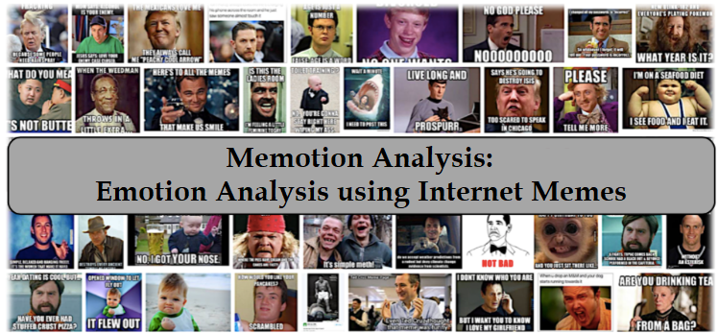

Slide 3

Outline
Research Problem
Literature Survey
Algorithm Implemented
Dataset
Results Obtained
Next Steps
Conclusion

Slide 4
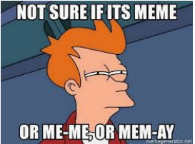
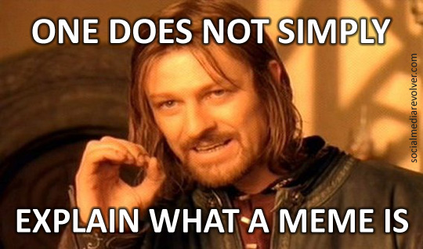
What is a Meme?
A meme is generally a humorous image
- with some text written on the image in most cases
- gets copied in its original form or with some slight variations
- becomes viral (spread throughout social media by users)
- can be used to convey a wide range of emotions
The word ‘meme’ itself is now one of the most typed English words [4]
Often derived from popular culture including a movie or a TV series or a popular cartoon character

Slide 5
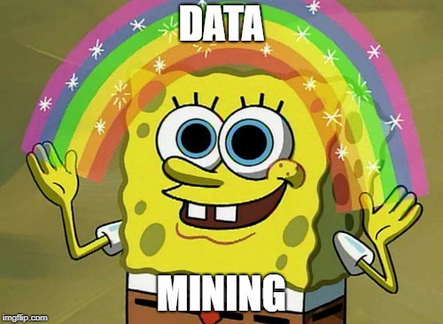
Research Problem
Memotion analysis is a challenging task as we would need to use a hybrid approach for performing computational processing of the memes
The initial research problem is sentiment classification where a given internet meme needs to be classified as a positive, negative or neutral one
The next problem is humor classification in which the type of humor (sarcastic, humorous, offensive, motivational) expressed by a given meme needs to be identified
The final problem is quantification i.e., quantifying the extent to which a particular effect is being expressed

Slide 6

Literature Survey
Memes can be used to understand the opinion of a community [5]
A crucial aspect that needs to be addressed is detection of offensive content on online social media [6]
Detecting an offensive meme is very challenging because it requires visual cue and language understanding
To extract the conveyed message, it’s very important to analyze and process the memes
Some researchers have explored the idea of automating the meme generation [7, 8] process, while some others tried to extract its inherent sentiment [9]
There is a significant scope in this case to incorporate more work for distinguishing the finer aspects of memes such as type of humor or offense

Slide 7
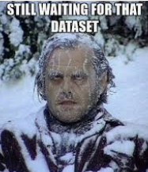
Dataset
The dataset has been collected from a challenge from SemEval-2020 (International Workshop on Semantic Evaluation 2020) competition
SemEval released around 7K annotated memes - with human annotated tags namely sentiment, and type of emotion that is, humorous, sarcastic, offensive, motivational
We’re using the training dataset (in csv format) from the challenge for both our training and testing purposes
The arrangement of the dataset didn’t properly match with the original problem description
We had to go through the entire dataset to address the ambiguities and re-organized the categories and sub-categories
We’ve performed extensive pre-processing operations on the dataset and eliminated the noise

Slide 8

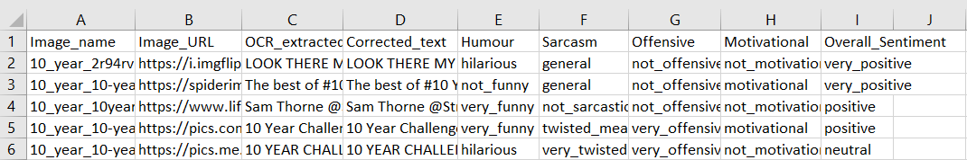
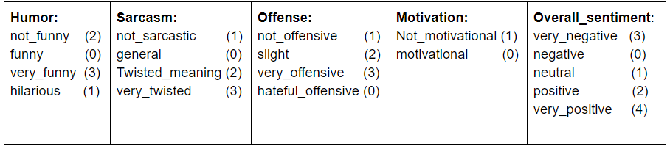
Dataset (Cont’d.)
View of the dataset:
Classes and Ordinality:

Slide 9

Algorithm Implemented
Initially we performed extensive pre-processing operations on the dataset
Then we used the following parameters for feature extraction:
Term Frequency-Inverse Document Frequency (TF-IDF) and
Count Vectors
Finally, to perform the memotion analysis task, we explored and implemented the following algorithms for building models -
Multinomial Naive Bayes Classifier
Linear SVM
Logistic Regression
Random Forest Classifier

Slide 10
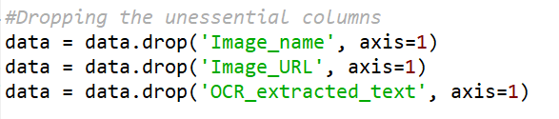
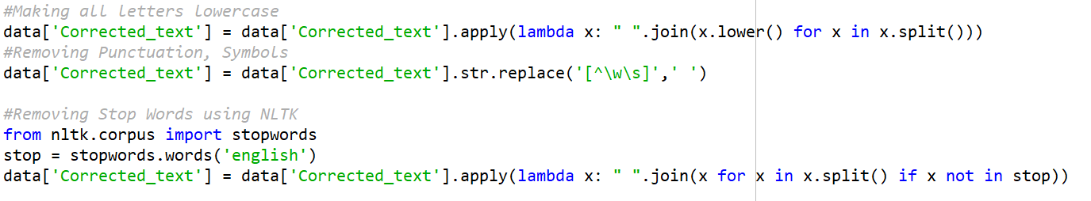
Code Snippets
Step-01: Preprocessing the Data

Slide 11
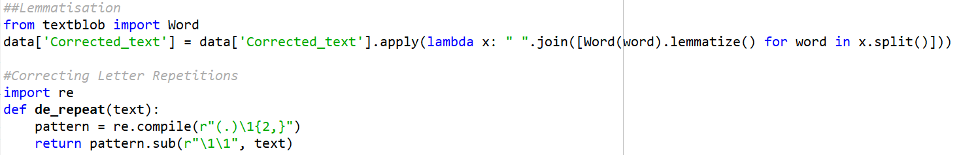
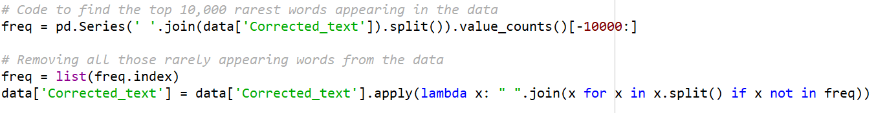
Code Snippets (Cont’d.)
Step-01: Preprocessing the Data

Slide 12
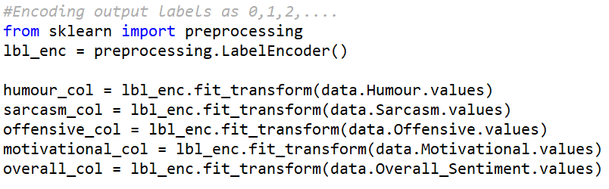
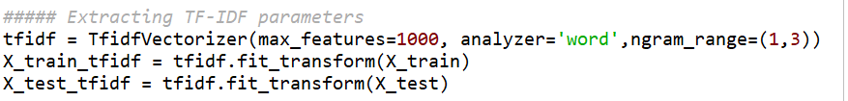
Code Snippets (Cont’d.)
Step-02: Feature Extraction

Slide 13
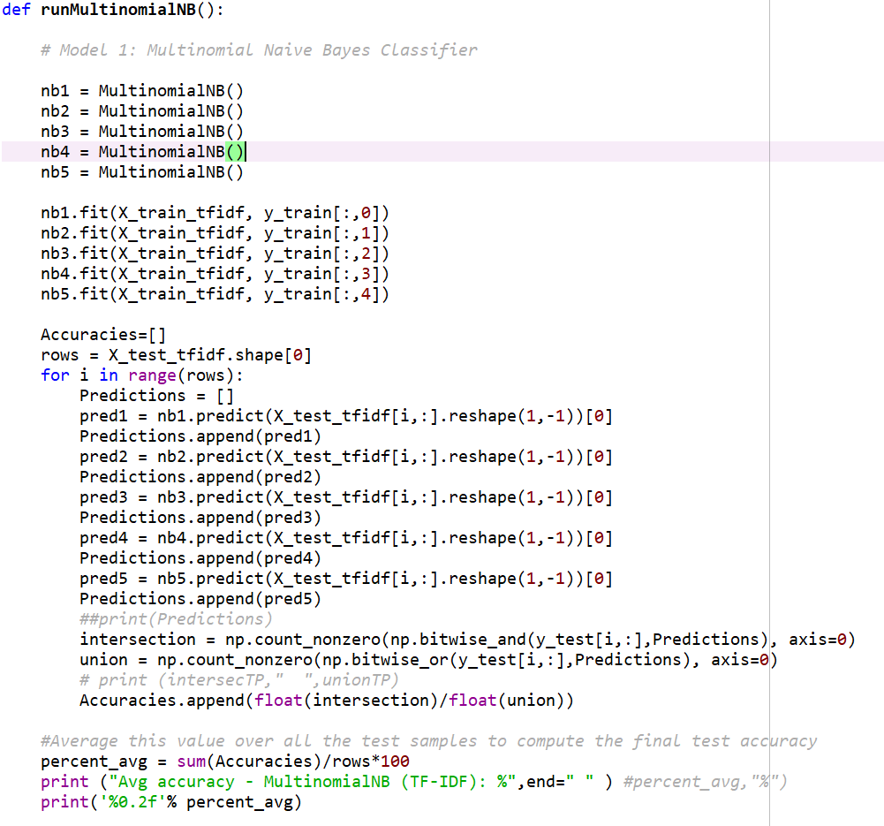
Code Snippets (Cont’d.)
Step-03: Training the Models

Slide 14
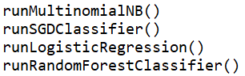
Code Snippets (Cont’d.)
Step-03: Training the Models
Each function calls the corresponding model
The models are trained individually
Average accuracy values are generated for each model

Slide 15
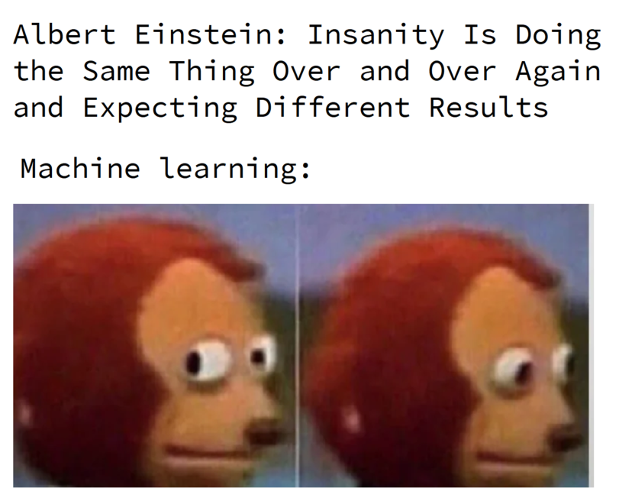
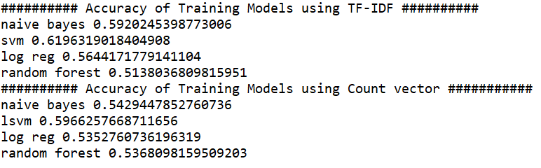
Results
Task-01: Sentiment Classification
For task-01, we’ve used two different parameters TF-IDF and Count Vectors with four different models to classify the memes in the dataset into three major categories - positive, negative or neutral
Accuracy of the best model: 61.96% (Linear SVM using TF-IDF)
Average accuracy for TF-IDF: 57.25%
Average accuracy for Count Vector: 55.28%

Slide 16
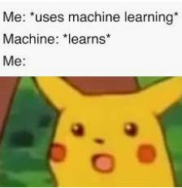
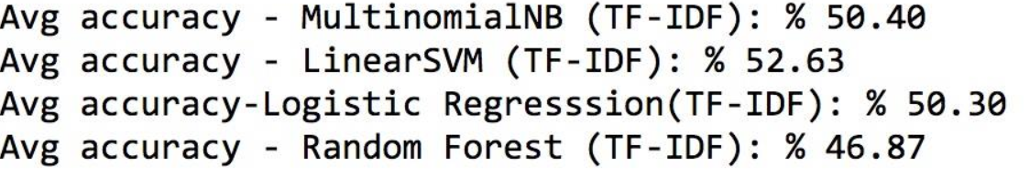
Results (Cont’d.)
Task-02 and Task-03: Humor Classification and Quantification
We’re approaching task-02 and task-03 as a combined task
Accuracy of the best model: 52.63% (Linear SVM using TF-IDF)
Average accuracy: 50.05% (TF-IDF)

Slide 17
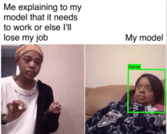

Other Approaches Explored
We also explored the following approaches
Ranking SVM
Ordinal Quantification
Some Regression techniques have also been explored
Linear Regression
Ridge Regression
Support Vector Regression

Slide 18

Next Steps
Currently we’ve implemented the models with TF-IDF, we would implement those for count vectors also
We’ll try to implement models with other suitable algorithms and compare the results with the already implemented ones

Slide 19
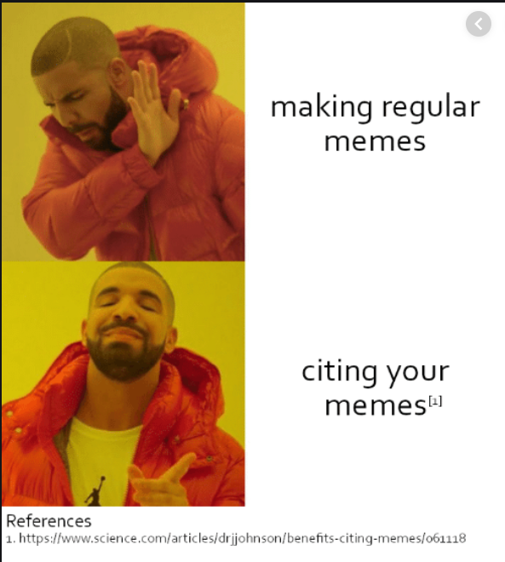
References
http://amitavadas.com/Memotion.html
https://competitions.codalab.org/competitions/20629
http://alt.qcri.org/semeval2020/index.php?id=tasks
Nikhil Sonnad. 2018. The world’s biggest meme is the word meme itself.
Noam Gal, Limor Shifman, and Zohar Kampf. 2016. it gets better: Internet memes and the construction of collective identity. New Media & Society, 18(8):1698–1714.
Amanda Williams, Clio Oliver, Katherine Aumer, and Chanel Meyers. 2016. Racial microaggressions and perceptions of internet memes. Computers in Human Behavior, 63:424–432.
V Peirson, L Abel, and E Meltem Tolunay. 2018. Dank learning: Generating memes using deep neural networks. arXiv preprint arXiv:1806.04510.
Hugo Goncalo Oliveira, Diogo Costa, and Alexandre Miguel Pinto. 2016. One does not simply produce funny memes!–explorations on the automatic generation of internet humor. In Proceedings of the 7th International Conference on Computational Creativity, ICCC.
J. H. French, "Image-based memes as sentiment predictors," 2017 International Conference on Information Society (i-Society), Dublin, 2017, pp. 80-85.
Zhang, M.L.; Zhou, Z.H. (2007). "ML-KNN: A lazy learning approach to multi-label learning". Pattern Recognition. 40 (7): 2038–2048. CiteSeerX 10.1.1.538.9597. doi:10.1016/j.patcog.2006.12.019.

Slide 20
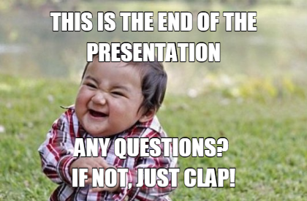
Notes:
20
20

Slide 21

Notes:
21
21

